Slide 1
SCIENTIFIC COMPUTING FOR BUILDING ENGINEERING​
Final Presentation G14​
01 September 2025​
POLITECNICO DI MILANO – SCIENTIFIC COMPUTING FOR BUILDING ENGINEERING
G14: FARNAZ VAFA – JACOPO GUERRINI – MOHAMMAD SHOJAEE – SALMA YANUAR​
241022_SCBE_FinalPresentation_G14​
PAGE 1

Slide 2



Team 14
Farnaz Ahmadi Vafa (FV)​
Civil Engineer​
Mohammed Amin Shojaee (MS)​
Civil Engineer​
Salma Nabilah Yanuar (SY)​
Architect​
PAGE 2

Slide 3

Turning Torso
This project focuses on optimizing the solar performance of twisted high-rise towers. Using the Turning Torso in Malmö as a case study, we applied parametric design, environmental simulation, and emulator modeling tooptimize the rotation and L1 in order to get close as possible to the design Value of 6000 kWh
PAGE 3

Slide 4
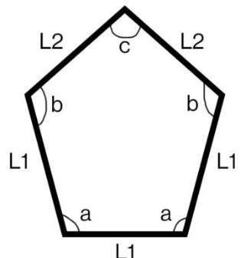
Background and Problem
Twisted towers = unique solar patterns.
Fixed perimeter floor plans are common in real design.
Gap: No combined analysis of rotation + proportions.
Turning Torso is an ideal test case.
Twisted towers interact with sunlight differently from straight towers. In real projects, perimeter constraints often limit design freedom. Previous research hasn’t fully explored how floor rotation and geometric proportions interact to affect solar gain. Turning Torso gives us a real-world, iconic example for testing.
PAGE 4

Slide 5




Objectives
TEST IMPACT OF FLOOR ROTATION AND PROPORTIONS
OPTIMIZE FOR 6000 KWH ON 21 DEC (WORST DAY)
COMBINE SIMULATION + EMULATOR FOR EFFICIENCY
CREATE A FLEXIBLE WORKFLOW FOR OTHER TOWERS
Our goals were to understand how geometry affects solar performance, optimize the design for a specific energy target, and build a workflow that can be reused for other twisted towers.
PAGE 5

Slide 6
Methodology Overview
PARAMETRIC MODELLING IN GRASSHOPPER
SIMULATION WITH LADYBUG TOOLS (MALMÖ EPW)
EMULATOR IN PYTHON
OPTIMIZATION WITH POWELL METHOD AND MINIMIZE FUNCTION
AUTOMATED GEOMETRY CONTROL AND DATA COLLECTION
1
2
3
4
5
We built a fully parametric model in Grasshopper, used Ladybug Tools with Malmö climate data for simulations, created a polynomial emulator in Python to speed up predictions, and ran an optimization algorithm to find the best design.
PAGE 6

Slide 7
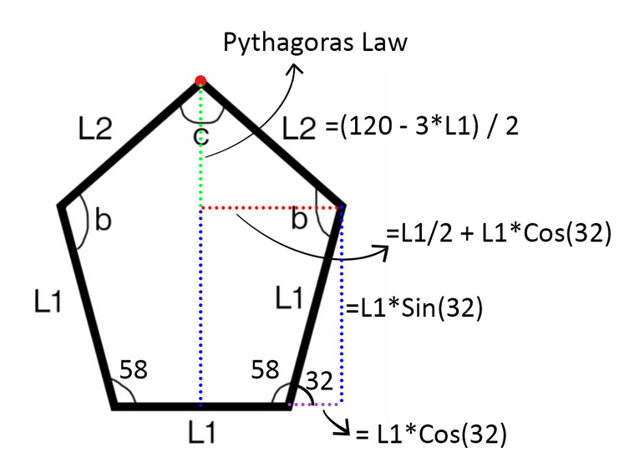
PARAMETRIC MODELLING IN GRASSHOPPER
1
A single floor plan was abstracted as a pentagon with alternating sides L1 and L2.
L1 was manually varied, L2 was auto-calculated to keep perimeter P constant.
Floor rotation (θ) was applied to simulate twisting across tower height.
Internal angles (b, c) updated automatically to maintain valid geometry.
L1 values (meters):
16, 17, 18, 19, 20, 21, 22, 23
Rotation angles (°):
10 to 120 (step of 10°)
Total configurations tested: 96 (in original case study)
Model built in Grasshopper for Rhino; phyton code controlled L1 and rotation angle to generate valid and diverse floor geometries for solar simulation.
PAGE 7

Slide 8
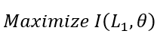
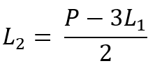
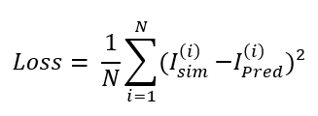
FORMALIZATION OF THE ADDRESSED PROBLEM
2
The goal is to find the best L1 and rotation (θ) that near to to the target value of solar irradiation on the façade.
The floor is a five-sided polygon with alternating sides L1 and L2.
L2 is calculated to keep perimeter constant using:
Solar irradiation is represented as I(L₁, θ), estimated using emulator.
The optimization domain is:
L₁ ∈ [16, 23] meters
θ ∈ [10°, 120°]
Initial Optimization Objective:
Loss Function (for emulator training):
Optimization type:
Simulation-based with emulator approximation
Total configurations simulated: 96
This problem is approached as a black-box optimization task where L1 and θ are inputs. Solar irradiation is predicted using a trained emulator, and the best combination is selected based on the minimum error.
PAGE 8

Slide 9
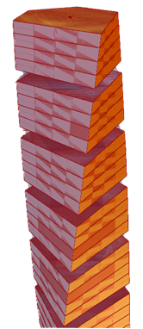
EMULATOR IN PYTHON
3
Emulator replaces slow simulations with fast prediction.
Trained on 96 configurations (L1, θ) with Ladybug results.
Predicts total solar irradiation (including walls, roof, and floor).
Key inputs:
L1 = pentagon edge (m)
θ = floor rotation (°)
THE MAIN PURPOSE
to find a polynomial surface (which has an equation) that fitsthe best to the original dataset so the values between the original dataset that was not calulated can be predicted and interpolated with the higher precision and ther is no need for iterating and modeling the builidng for all the values
Purpose
Fast prediction for new L1, θ combinations
Design exploration without re-running simulations
Speed up optimization routines
Find the best polynominal that fits well based on the original data
The emulator bridges parametric modeling, simulation, and data-driven prediction, supporting real-time performance evaluation.
PAGE 9

Slide 10
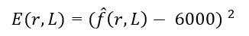
OPTIMIZATION WITH POWELL ALGORITHM
AUTOMATED GEOMETRY CONTROL AND DATA COLLECTION
4
5
Goal: Find L1 and θ that get close to 6000 kWh on Dec 21
Polynomial surface from emulator used in optimization
Error function:
Solver: Powell’s algorithm (SciPy)
L1 ∈ [16, 23] meters
θ ∈ [10°, 120°]
Python replaced manual Grasshopper inputs
L1 and top vertex coordinates calculated using math formulas
Geometry auto-updates to satisfy fixed perimeter
α kept fixed; L2 recalculated from L1
Script 1:
Controls L1, θ, floors, and location
Run and control by a trigger
Iterates over full range with delay
Script 2:
Collects total incident irradiation + surface area
Stores full dataset in CSV (6 values per row)
Instead of maximizing a global peak, the optimizer finds the closest match to the required energy target, improving design realism
Python scripting reduced manual work, ensured consistency, and enabled large-scale testing of geometric and environmental combinations.
PAGE 10

Slide 11
Results : Parametric Modelling
Generate Tower Geometry
Use the Series component to define Z-heights for each floor (every 4 meters).
Apply Move to vertically stack identical pentagonal floor plates.
Apply Progressive Floor Rotation
Multiply base angle θ by floor index to simulate twist.
Use Rotate and DegToRad to apply rotation
Create Tower Shell
Apply Loft to connect all floors into one continuous surface.
Use Cap Holes to close the geometry, forming a solid for analysis.
Calculate Surface Area
Use the Area component to calculate each face.
Apply Mass Addition to sum values and get the total façade surface area.
Simulate Solar Irradiation
Import EPW climate data (Malmö) via Ladybug.
Convert geometry to mesh for per-face solar evaluation.
Visualize cumulative irradiation using Ladybug irradiation analysis, with color mapping
1
2
3
4
5
PAGE 11

Slide 12
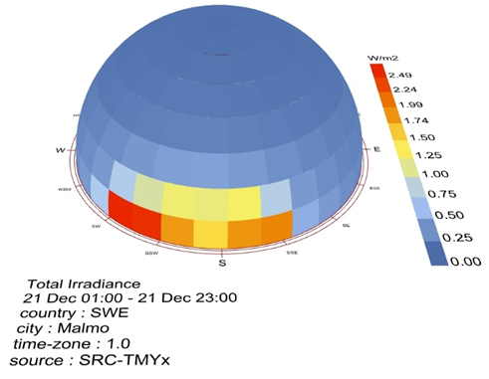
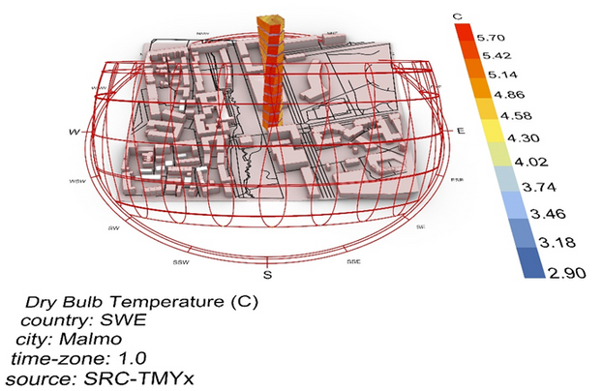
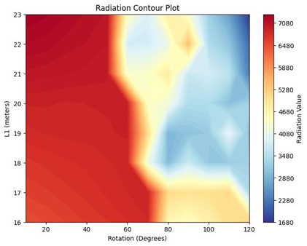
Results : Radiation Analysis
Performance Insight Through Climate-Based Simulation
Climate Setup
Used EPW weather data for Malmö
Simulated worst-case solar day: 21 December
Target: 6000 kWh irradiation to meet energy needs year-round
Solar Context & Temperature
Analyzed dry bulb temperature distribution
Coldest zones: North/Northeast
Warmest exposure: South-facing
Radiation Contour Plot
Highest irradiation at low rotation (10°–50°) and longer L1
L1 > 20 m gives consistently higher values
1
2
3
PAGE 12

Slide 13
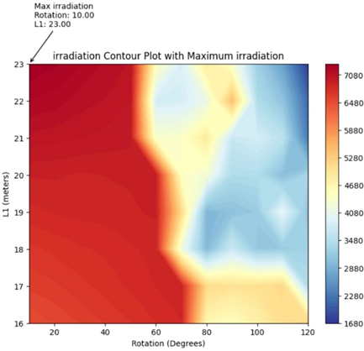
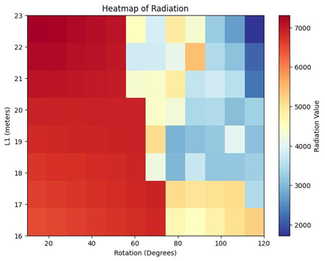
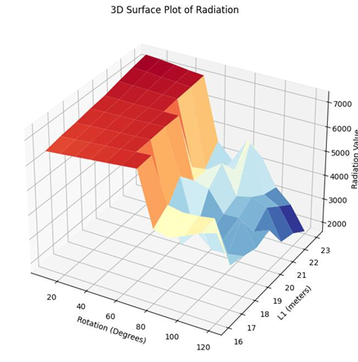
Rotation Sensitivity (L1 = 23 m)
Sharp drop in performance after 50° rotation
Confirms self-shading and misalignment at high angles
Heatmap Visualization
Visualizes performance gradient
Red zone (top-left) = best config (low rotation, high L1)
Steep drop-off beyond 60°
3D Surface Plot
Clear peak at L1 = 23 m, θ = 10°
Decline along rotation axis = high impact of twisting
4
5
6
Rotation impacts solar gain more than L1 Best config: L1 = 23 m, θ = 10°
Performance-focused geometry requires early parametric evaluation
PAGE 13

Slide 14
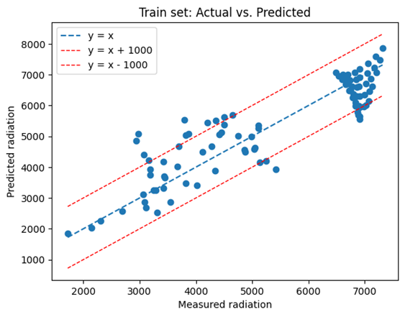
Results : Emulator Model Development
From Simulation to Prediction
1
Polynomial Regression Setup (second degree)
Starting from the simpleased surface equation with 2 degree
valuate the error between the original data and the corrisponding point on polynomial surface
Try to reduce this error by using higher degree surfaces; this, was done by evaluating the R2 and MSE of the model and org. dataset
At the end by cross validation we found the the equation degree that has the highest R2 and and lowest MSE
PAGE 14

Slide 15
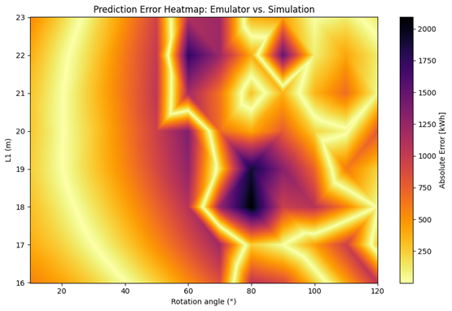
Results : Emulator Model Development
From Simulation to Prediction
2
Evaluate 2nd-Degree Model
SSE reduced by 80.2%, but error remained in high-radiation zones
Error heatmap revealed performance drop in complex zones
PAGE 15

Slide 16
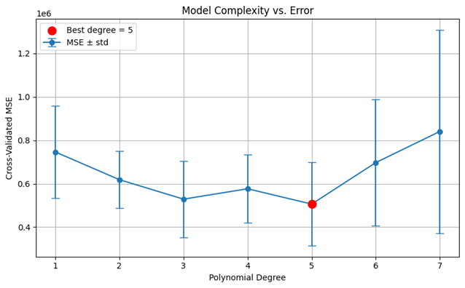
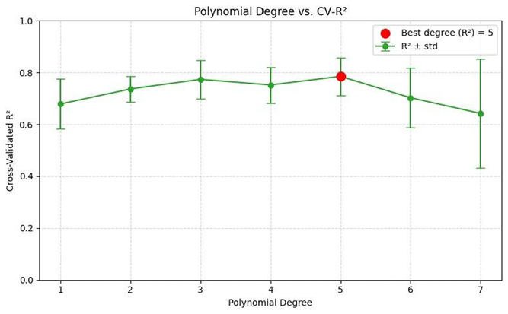
Results : Emulator Model Development
From Simulation to Prediction
3
Upgrade to 5th-Degree Model
Added full polynomial terms up to degree 5 (21 features)
7-fold cross-validation used to avoid overfitting
Best fit at degree = 5:
MSE: 506,130 ± 192k
R² = 0.785
PAGE 16

Slide 17
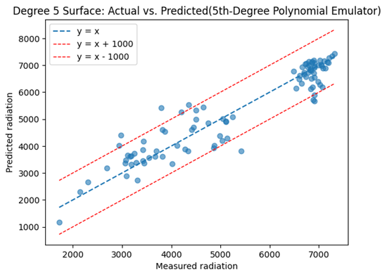
Results : Emulator Model Development
From Simulation to Prediction
4
Accuracy Improvement
SSE dropped by 88.6% → better than 2nd-degree
Visual results: tighter cluster along y=x
PAGE 17

Slide 18
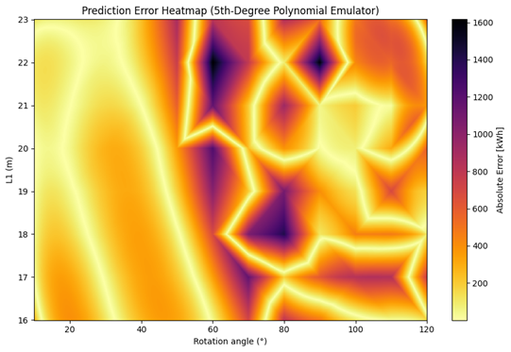
Results : Emulator Model Development
From Simulation to Prediction
5
Local Error Heatmap
Lower error in low rotation zones
Some localized overfitting in high rotation/high L1 areas
PAGE 18

Slide 19
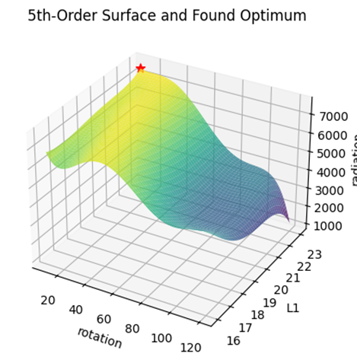
Results : Emulator Model Development
From Simulation to Prediction
5
Test Predictions & Global Optimum
Known input (20°, 20m):
5th-degree: 6900.63 kWh
Actual: 6909.38 kWh
Best config:
Conclusion
5th-degree emulator captures non-linear behavior
Enables fast and accurate prediction without simulation
Supports design space exploration and optimization
PAGE 19

Slide 20
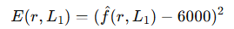
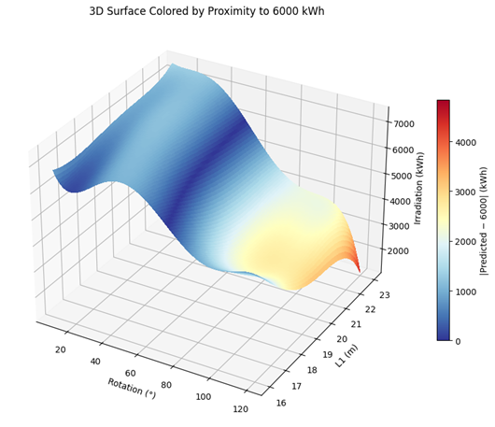
Results : Optimization
Finding the Geometry That Achieves 6000 kWh
Optimization Results
Converged at:
Rotation: 53.15°
L₁ length: 22.13 m
Radiation: 6000.00 kWh
Error²: 0.0000
1
3
Define the Objective Function
Goal: minimize squared error from target radiation (6000 kWh)
Error function:
f̂ is the 5th-degree emulator predicting radiation
2
Set Up SciPy Optimizer
Optimizer: scipy.optimize.minimize using Powell method
Bounds:
r ∈ [10°, 120°]
L₁ ∈ [16 m, 23 m]
Start point: previously found maximum (10°, 23 m)
Final Irradiation Value
5999.89 kWh
PAGE 20

Slide 21
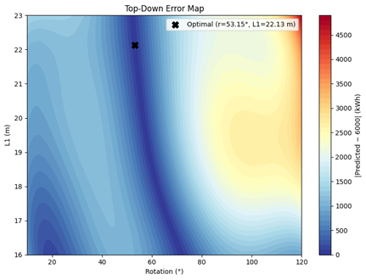
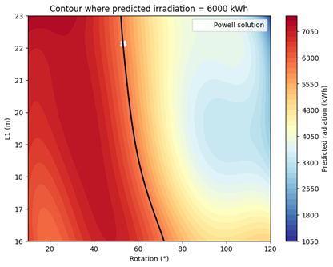
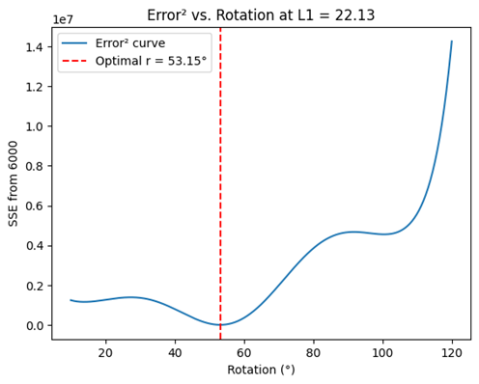
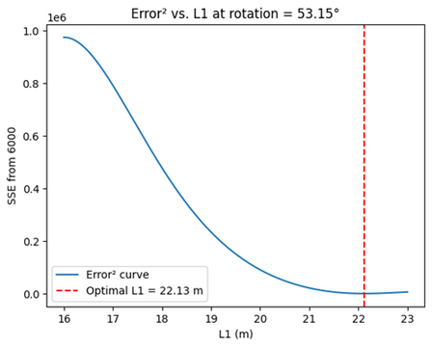
4
5
Visualize Error Zones
Blue regions = (r, L1) pairs close to 6000 kWh
Red regions = high error
Shows optimizer’s local convergence despite multiple near-optimal basins
Understand Variable Sensitivity
Error vs Rotation (at fixed L₁ = 22.13)
Error vs L₁ (at fixed r = 53.15)
Shows how optimization “locks in” variables that minimize deviation
Using a 5th-degree emulator + Powell optimization, we precisely reached the 6000 kWh target The optimizer identifies one solution, even though multiple may exist, due to stopping criteria and local minimal, This confirms the workflow is accurate, efficient, and ready for use in performance-driven parametric design
PAGE 21

Slide 22
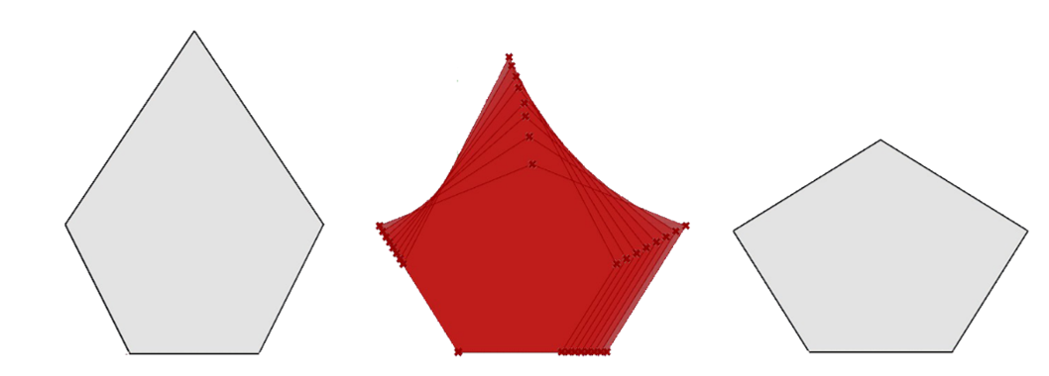
Results : Optimized Floor Plan Design
From Initial Geometry to Solar-Optimized Solution
Initial Shape (left) : Regular pentagon with equal side lengths and no rotation
Parametric Variations (middle) : Generated by adjusting L1 and L2 while keeping perimeter constant → Explored entire design space in Grasshopper
Simulation & Emulator : Each configuration evaluated with Ladybug → Trained polynomial emulator
Optimization (right) : Python + Powell method → Found floor plan with 6000 kWh irradiation
Final Geometry : Optimized proportions and rotation yield high-performance floor design
PAGE 22

Slide 23
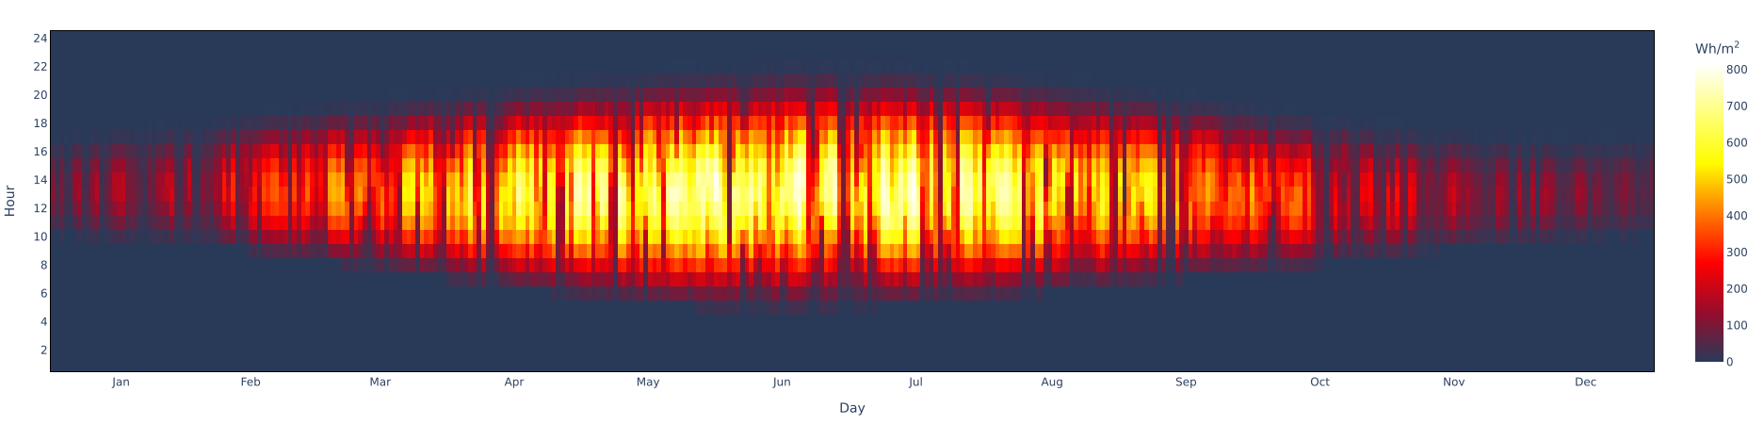
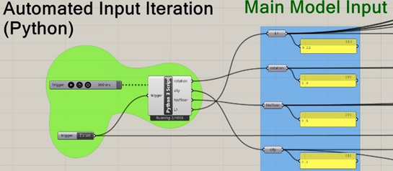
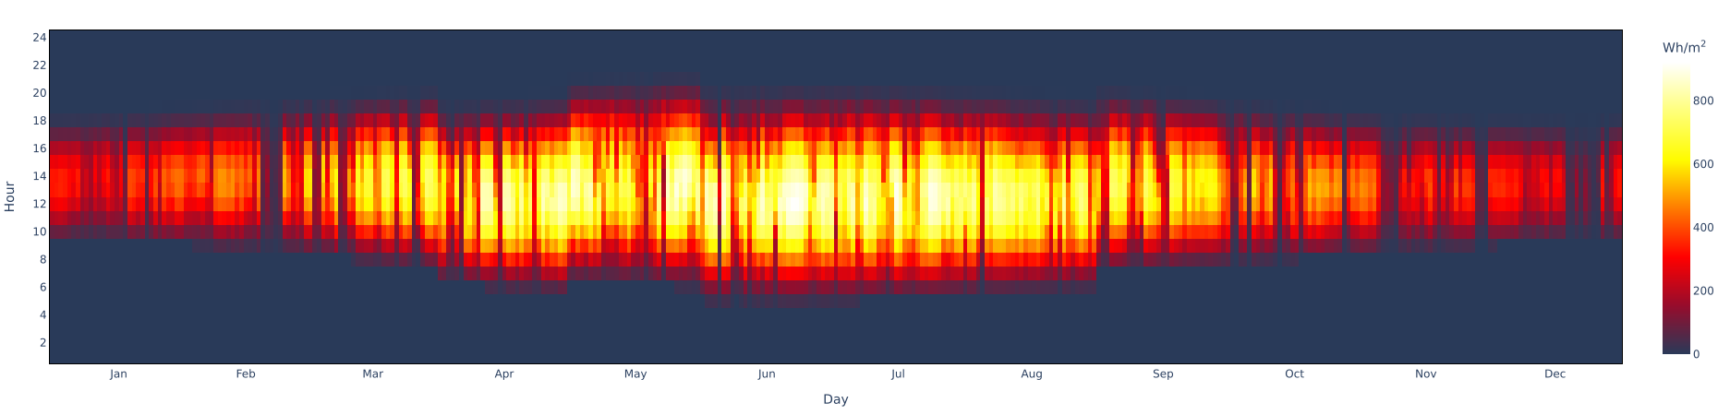
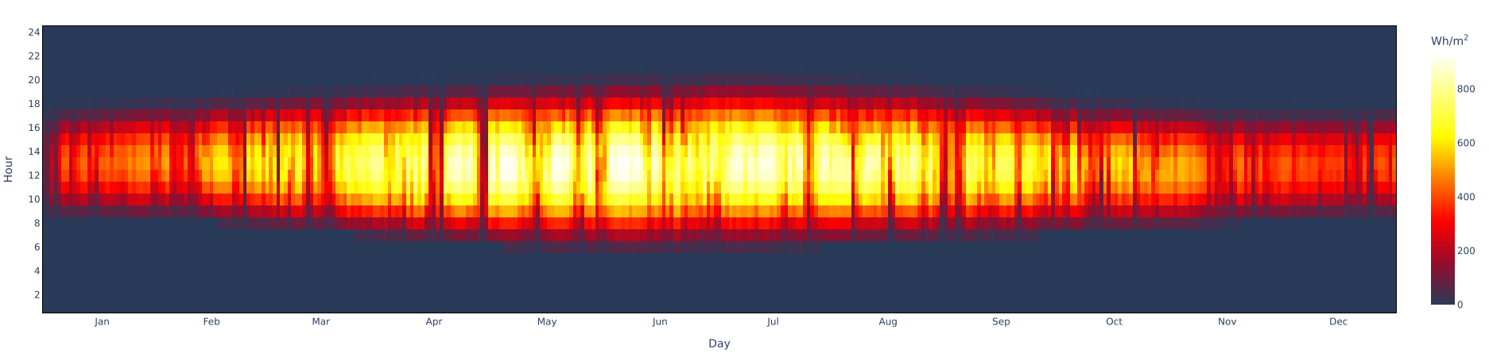
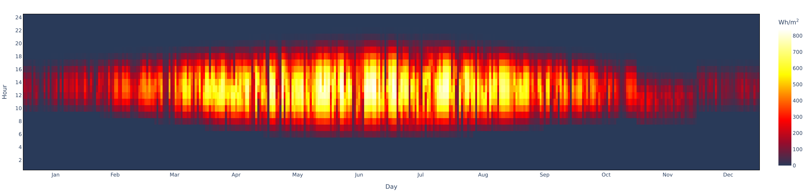
Innovation and Broader Implications
Automatic Iteration in Python
Different EPW
Malmo
Sweden
Milan
Italy
Barcelona
Spain
This study presents a novel method to analyze twisted towers.
Parametric model + online platform = no advanced modelling expertise required.
Enables direct input of parameters to estimate solar irradiation and surface area
Berlin
Germany
Further improvement by using different cities EPW
PAGE 23

Slide 24
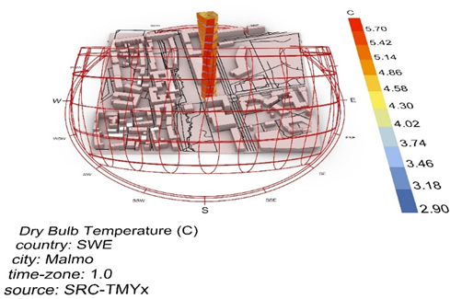
Innovation and Broader Implications
Base Geometry based on Phyton Code
Context-Based Radiation Analysis
The local shade of nearby building might affect the total irradiation fall on the building facade, hence we assign the context for higher precision irradiation analysis
PAGE 24

Slide 25
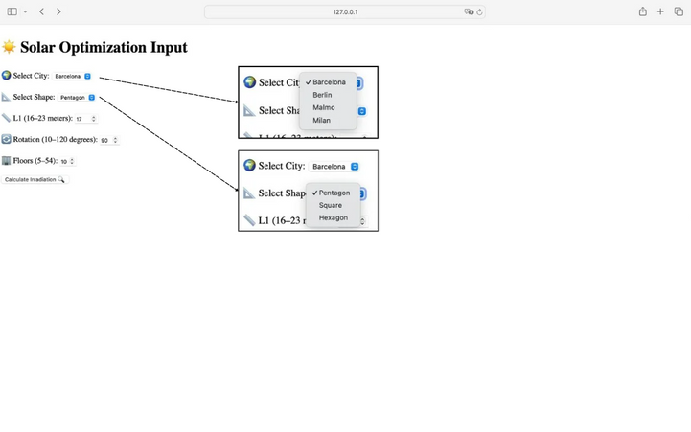
Innovation and Broader Implications
User-friendly Interface
To extend the flexibility of the parametric workflow, a user-friendly interface was developed using Python. This platform allows users to select the city (e.g., Barcelona, Malmö, Milan), floor shape (pentagon, square, hexagon), and geometric inputs like L1 and rotation angle. The application instantly calculates the expected irradiation, making the optimization process accessible without needing to open Rhino-Grasshopper or run simulations manually.
PAGE 25

Slide 26
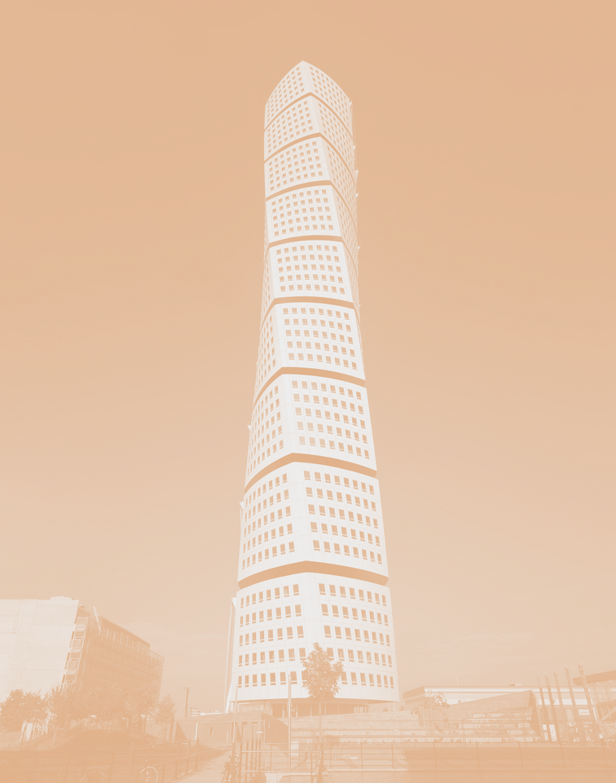
Conclusion
This project explored how parametric modeling and emulator-based optimization can guide solar-responsive design in twisted high-rise towers. Using the Turning Torso in Malmö as a case study, we found that low rotation angles (around 10°) and longer floor edges (L1 = 23 m) maximize solar gain. By training a fifth-degree polynomial emulator, we achieved high predictive accuracy (88.6% SSE reduction), enabling fast and precise optimization toward a 6000 kWh radiation target.
While some local prediction errors remain, the workflow—combining Grasshopper, Ladybug, Python, and SciPy—proves flexible, efficient, and scalable. It contributes not only to sustainable tower design in low-sun climates, but also to broader applications of data-driven geometry in architecture
PAGE 26

Slide 27

Turning Torso

